Slide 1
M-BLANK MANUAL FIGURES

Slide 2
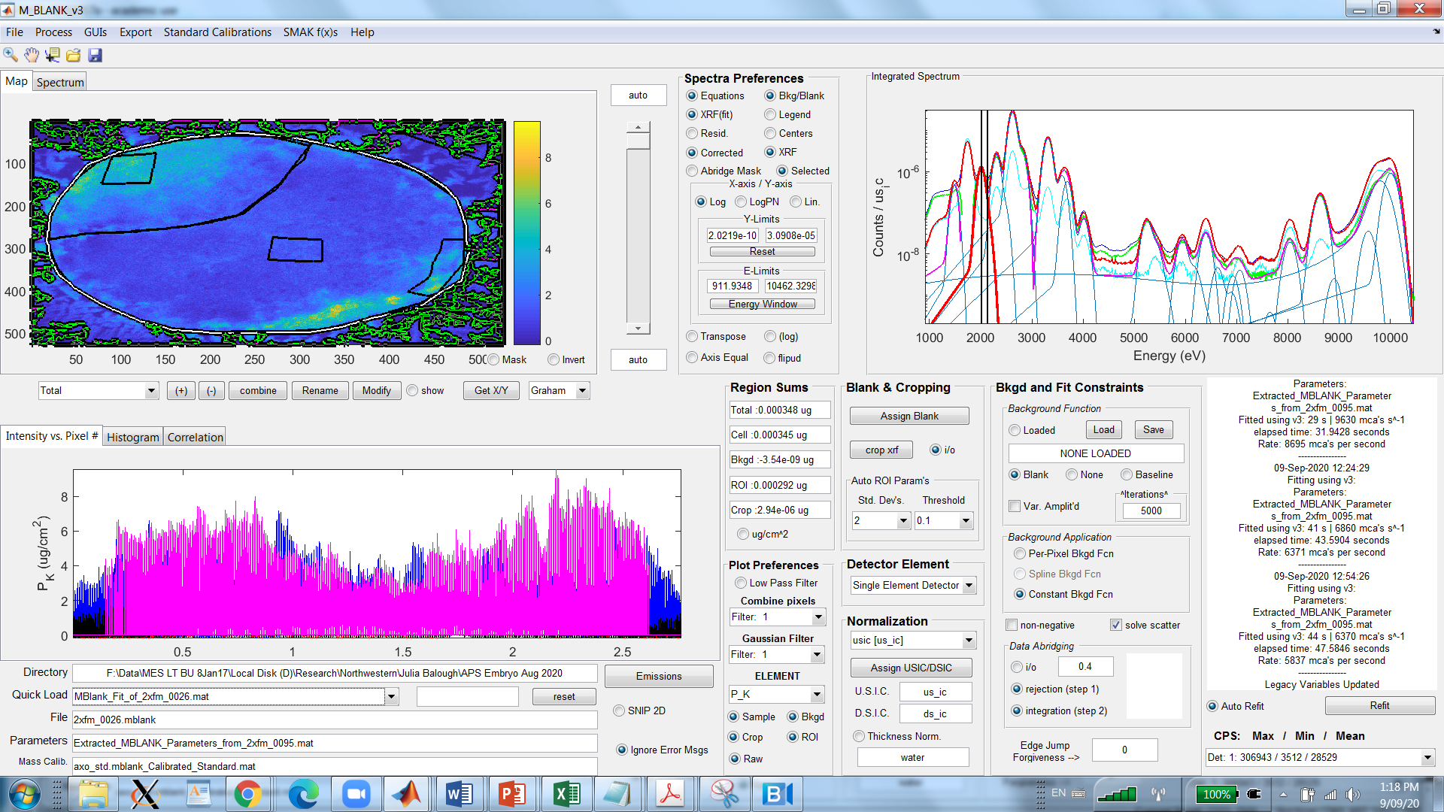
4.4
4.2
4.3
4.6
4.7
4.8
4.9
4.5
4.1

Slide 3
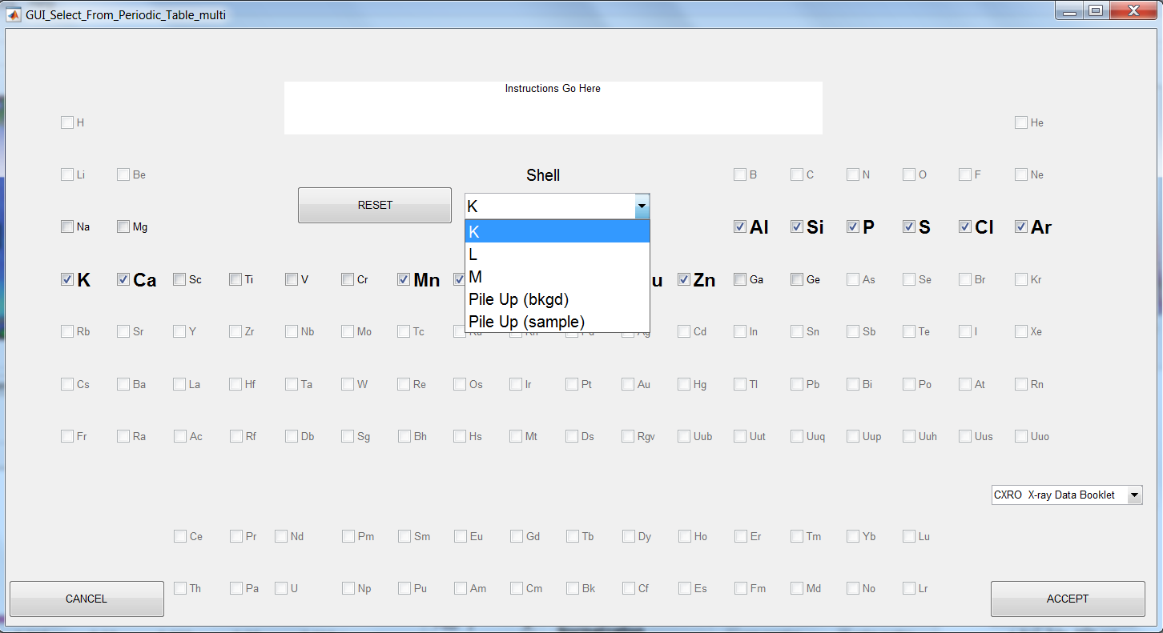
a
h
b
c
d
i
e
f
j
g
n
l
k
o
m
p

Slide 4
a
b
c
d

Slide 5
uicontext menu (mouse r-click)

Slide 6
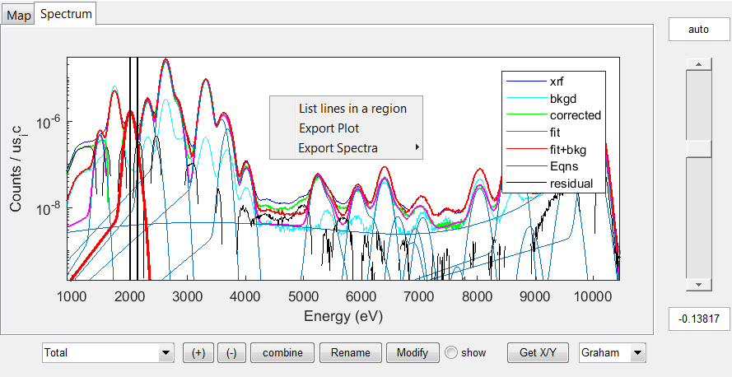
p
a
b
n
s (uicontext menu; mouse r-click)
r (uicontext menu; mouse r-click)
q
l
m
o
c
d
e
f
g
h
i
j
k

Slide 7
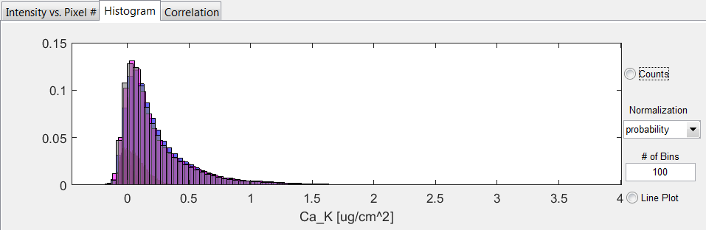
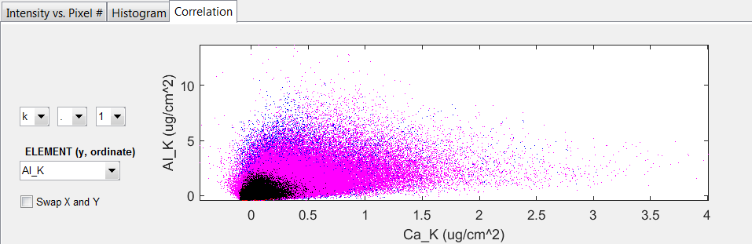
a (uicontext menu; mouse r-click)
b (uicontext menu; mouse r-click)
d
e
f
g
h
c (uicontext menu; mouse r-click)
i
j

Slide 8
a
b
c
d
e
f
g

Slide 9
b
a
c
d
e
f
g
h
i
j

Slide 10
a
b
c
d
e
f
g
i
h
j
k
l
m
n
o
p
q

Slide 11
a
b
c
d

